Slide 1
Module 2: Tower, Galaxy & Roles

Slide 2
Identify
Define

Slide 3
Topic List
Ansible Tower – Installation, setup & verification
Ansible Galaxy
Roles

Slide 4
Topic List
Ansible Tower, installation, setup & verification
Galaxy
Roles

Slide 5
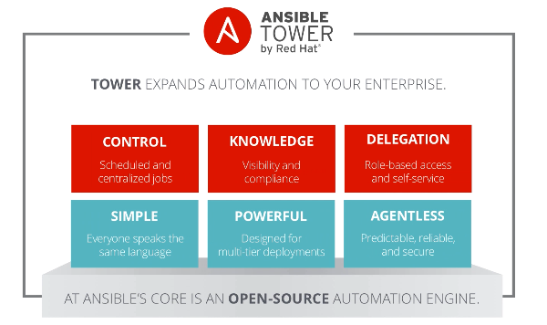
Ansible Tower
Tower is a UI & API, that centralizes Ansible runs
Also makes it easier to integerate ansible with other systems,
Workflows required for CI/CD pipelines
All playbook runs are stored and captured inside Tower.
Who ran what job, which systems were updated, the output of each system and so on
Tower enables to define precise roles and responsibilities
Safe automation on cloud without exposing credentials to the user

Slide 6
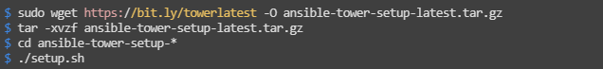
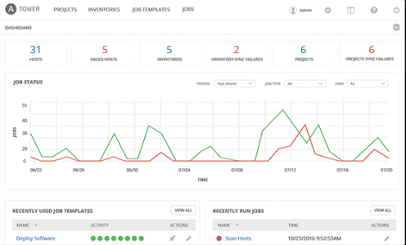
Installation of Tower
Install Tower :
If no access to EPEL, use https://bit.ly/towerbundlelatest
Requirements
Red Hat Enterprise Linux 7, CentOS 7, or Ubuntu 14.04
64-bit support required for kernel and runtime
Currently supported version of Mozilla Firefox or Google Chrome
2 GB RAM minimum (4+ GB highly recommended)
20 GB of dedicated hard disk space

Slide 7
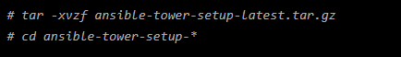
Installation of Tower
Connect to the control node
Become the root user
Connect to the tower node using the password
Install Ansible Packages and Enable EPEL Repository
Attach the Extra Packages pool to make Ansible packages available:
Install Ansible Tower Package
Get the latest Ansible tower installation package
Decompress the archive and change the folder

Slide 8
Setup & verify installation
Edit the inventory file passing the variable values. (Because the setup script uses Ansible to install Ansible Tower, you can change the installation parameters by modifying the inventory file.)
Launch the Ansible Tower setup script
# ./setup.sh
Verify Installation
Go to https://tower-GUID.rhpds.opentlc.com.
Accept the SSL certificate warnings from your web browser, if needed.
Confirm that you see this login screen:
License: download a valid License file. Check the agreement box at the bottom and click Submit & the Ansible Tower dashboard opens.
Launch Job: From the menu at the top of the Ansible Tower dashboard, select TEMPLATES. Once clicked to launch the Demo Job Template, you will see information about the job and the live output of the run.

Slide 9
Topic List
Ansible Tower, installation, setup & verification
Galaxy
Roles

Slide 10
Galaxy
Galaxy is the source of community and vendor-provided Ansible roles to help you get started faster.
Enables you to learn from others that are automating using ansible
Galaxy roles are often directly runnable with little modification
Allows to download and customize roles before running the environment.

Slide 11
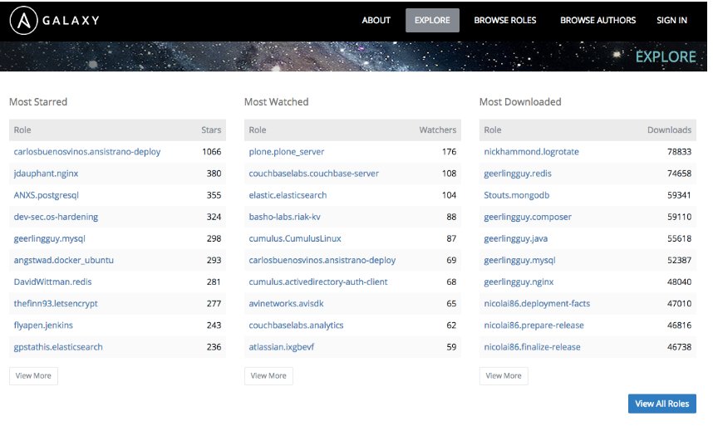
Galaxy
Example: Use a role from galaxy to set up a database.
Steps:
Download a Role from Ansible Galaxy Website
Use the Explore tab on the Ansible Galaxy website
to find a role created by someone in the community.
Go to https://galaxy.ansible.com/explore#/:
This page list some of the top roles created by the community.

Slide 12
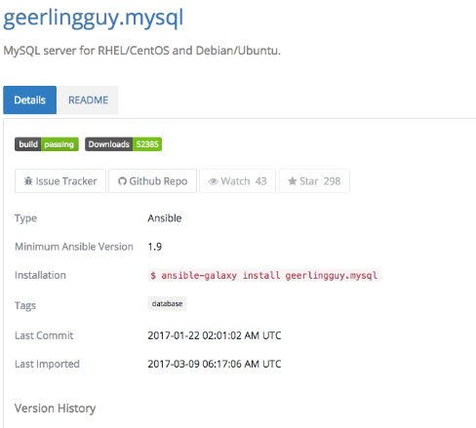
Galaxy
Select the following MySQL role: https://galaxy.ansible.com/geerlingguy/mysql/.
This page displays the ansible-galaxy command to use in order to install the role to your environment.
This role was the "Most Starred" MySQL role when Red Hat created this lab.

Slide 13
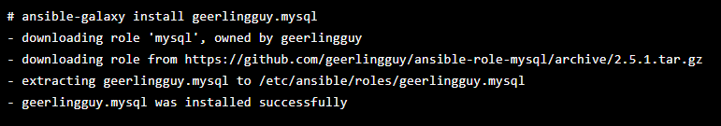
Galaxy
Install Galaxy role
Install an ansible Galaxy role
Connect to your Workstation
As root, install the mysql role you just viewed
The role is downloaded and extracted by default into the /etc/ansible/roles/ folder

Slide 14
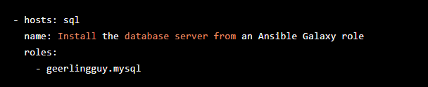
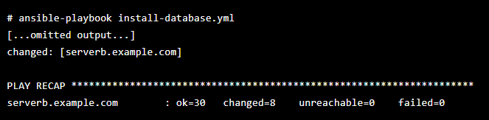
Galaxy
Use Ansible Galaxy Role
Create a new playbook called install-database.yml and add the following content
This playbook uses the geerlingguy.mysql role on the sql group you defined previously in your inventory
Run the playbook
Watch the playbook run and observe all of the tasks as they are performed.
The creator of this role uses many best practices to install and secure a MySQL server, and it is easy to read and understand no matter what technical level you have with MySQL servers

Slide 15
Topic List
Ansible Tower, installation, setup & verification
Galaxy
Roles

Slide 16
Roles
Galaxy Datacenters include variety of host types:
Web servers
Database servers
Hosts containing software development tools
Playbooks require tasks and handlers to manage these
Result: large and complex playbooks
Roles can split playbooks into smaller playbooks and files
Benefits
Roles promote easy sharing of content.
Roles define system type elements:
Web server
Database server
Git repository
Other purposes
Roles make larger projects more manageable
Administrators can work on different project roles in parallel

Slide 17
Roles
Role uses
Role Uses
Enable Ansible to load components from external files:
Tasks
Handlers
Variables
Associate and reference:
Static files
Templates
Files defining roles:
Given specific names
Organized in directory structure
Roles written as general purpose can be reused

Slide 18
Roles
Structure
Structure
Role functionality defined by directory structure
Top-level directory: Defines role name
Some subdirectories: Contain main.yml file
files and templates subdirectories: Contain objects referenced by main.yml files

Slide 19
Roles
Tree command displays user.example directory structure:
[user@host roles]$ tree user.example
user.example/
├── defaults
│ └── main.yml
├── files
├── handlers
│ └── main.yml
├── meta
│ └── main.yml
├── README.md
├── tasks
│ └── main.yml
├── templates
├── tests
│ ├── inventory
│ └── test.yml
└── vars
└── main.ym

Slide 20
Roles
Defaults : .
main.yml contains default values for role variables
Values can be overwritten when role is used
Files: Contains static files referenced by role tasks
handlers : main.yml contains role handler definitions
meta: :main.yml defines role information, Includes author, license, platforms, optional dependencies
Tasks: main.yml contains role task definitions
templates: Contains Jinja2 templates referenced by role tasks
Tests: Can contain inventory and test.yml playbook. Used to test role
Vars: main.yml defines role variable values

Slide 21
Roles
Variables and Defaults
To define role variables, create vars/main.yml with name/value pairs in hierarchy
YAML uses role variables like any other variable: {{ VAR_NAME }}
High priority
Cannot be overridden by inventory variables
Use default variables to set default values for included or dependent role variables
To define default variables, create defaults/main.yml with name/value pairs in hierarchy
Lowest priority of any variables
Overridden by any other variable
Best practice: Define variable in vars/main.yml or defaults/main.yml
Use default variable when role needs value to be overridden

Slide 22
Roles
Roles in playbooks
Simple to use roles in playbooks:
---
- hosts: remote.example.com
roles:
- role1
- role2

Slide 23
Roles
Included components
For each role, include the following in playbook in this order:
Tasks
Handlers
Variables
Dependencies
Role tasks (copy, script, template, include) reference files, templates, tasks
Ansible searches for items in the following locations:
Files: files
Templates: templates
Tasks: tasks
Eliminates need for absolute or relative path names

Slide 24
Roles
Order of execution
Default: Role tasks execute before tasks of playbooks in which they appear
To override default, use pre_tasks and post_tasks
pre_tasks: Tasks performed before any roles applied
post_tasks: Tasks performed after all roles completed
---
- hosts: remote.example.com
pre_tasks:
- shell: echo 'hello'
roles:
- role1
- role2
tasks:
- shell: echo 'still busy'
post_tasks:
- shell: echo 'goodbye'

Slide 25
Roles
Roles Creation
Simple to create roles in Linux
No special development tools required
Three-step process:
Create role directory structure
Define role content
Use role in playbook.

Slide 26
Roles
Roles creation - Directory structure
Ansible looks for roles in:
roles subdirectory
Directories referenced by roles_path
Located in Ansible configuration file
Contains list of directories to search
Each role has directory with specially named subdirectories
Subdirectories
files and templates
Contain fixed-content files and templates
Can be deployed by role when it is used
Other subdirectories
Contain main.yml files
Define default variable values, handlers, tasks, role metadata, variables
Empty subdirectory is ignored
Subdirectory not used by role can be omitted

Slide 27
Roles
Define Role Content
After creating structure, define role content
Use ROLENAME/tasks/main.yml
Defines modules to call on managed hosts where role is applied
Content Example
tasks/main.yml file manages /etc/motd on managed hosts
Uses template to copy motd.j2 to managed host
Retrieves motd.j2 from role’s templates subdirectory:
[user@host ~]$ cat roles/motd/tasks/main.yml
---
# tasks file for motd
- name: deliver motd file
template:
src: templates/motd.j2
dest: /etc/motd
owner: root
group: root
mode: 0444

Slide 28
Roles
Default variable values
Role can define default value for system_owner
Default values set in defaults/main.yml in directory structure
Example: defaults/main.yml sets system_owner to user@host.example.com
Email address written in /etc/motd of managed hosts where role is applied:
[user@host ~]$ cat roles/motd/defaults/main.yml
---
system_owner: user@host.example.com

Slide 29
Roles
Use in playbook
To access role, reference it in roles: playbook section
Example: Playbook referencing motd role
No variables specified
Role applied with default variable values:
[user@host ~]$ cat use-motd-role.yml
---
- name: use motd role playbook
hosts: remote.example.com
user: devops
become: true
roles:
- motd

Slide 30
Roles
Playbook output
In playbook output, tasks executed due to role identified by role name preceding task
Example: deliver motd file task prefaced by motd role name
Indicates task triggered by role:
[user@host ~]$ ansible-playbook -i inventory use-motd-role.yml
PLAY [use motd role playbook] **************************************************
TASK [setup] *******************************************************************
ok: [remote.example.com]
TASK [motd : deliver motd file] ************************************************
changed: [remote.example.com]
PLAY RECAP *********************************************************************
remote.example.com : ok=2 changed=1 unreachable=0 failed=0

Slide 31
Thank You

